Slide 1
What is MGO?
Metal Gear
A bipedal nuclear-equipped tank
Online
Controlled by or connected to a network.
Metal Gear Online
A bipedal nuclear tank controlled by the internet
Notes:
Not the final contents, just fillter

Slide 2
Cyber Necromancy:
Reverse Engineering Dead Protocols

Slide 3
Matthew Halchyshak
Security Technician

Slide 4
Joseph Tartaro
Senior Security Consultant for IOActive

Slide 5
Warning
Not development
Not exploitation
Just a cool project

Slide 6
The Project
Notes:
Revive Metal Gear Online 1 and 2

Slide 7
Problems
Servers are down
Minimal Packet Capture
No LAN Play
PS2 (mips32)
No debugging interface
PCSX2 Memory Dumps
PS3 (Cell BE)
Removed with official update
Requires a custom firmware
Notes:
Usually there is a reference implementation to see how the server responds
LAN play lets you keep playing online with a fake LAN
PC applications you have tool suites to help, consoles not so much

Slide 8
High-level Overview
Redirect traffic to our controlled server
Implement handlers for known protocols
HTTP
STUN
etc.
Implement unknown game protocol

Slide 9
Traffic Redirection

Slide 10
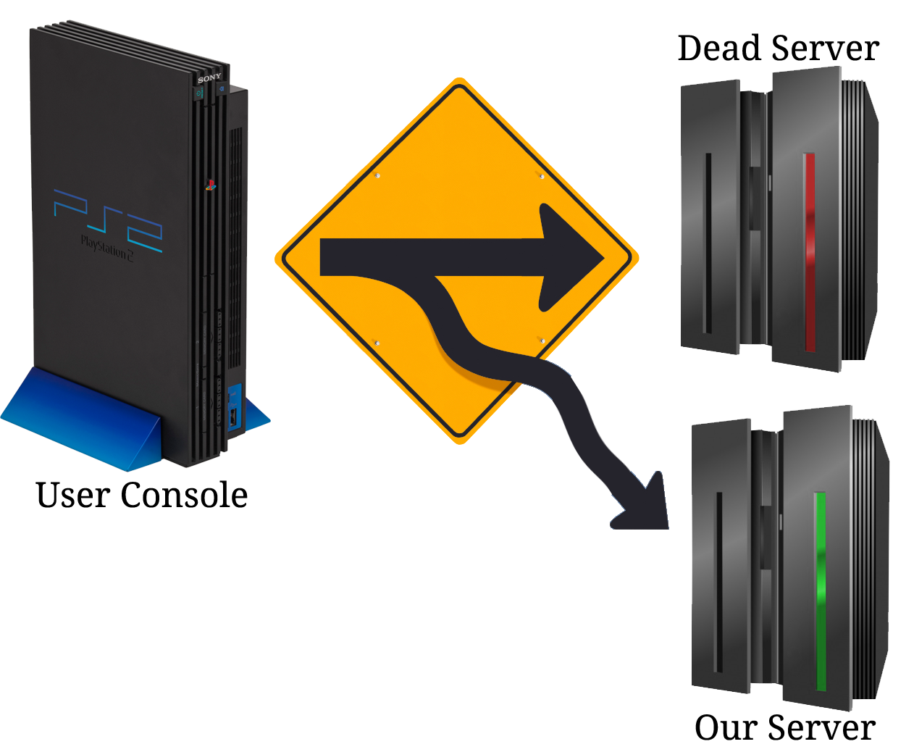
Traffic Redirection
Patching
Distribution?
Buy the domains
Still owned
Custom DNS

Slide 11
Walkthrough
Notes:
This is an overview of the easy stuff
We will deal with the technical issues in the next section

Slide 12
STUN Protocol
Non-issue
Run your own with stund
or point the DNS record to a public server
Notes:
STUN was quick and easy to get going

Slide 13
Dynamic Network Authentication
Prevent cheating and piracy online
Bypass for piracy is old
Bypass for games no longer online is not
Google is your friend
Sony SDK
DNAS Documentation
Notes:
DNAS was biggest issue at first for MGO1

Slide 14
Dynamic Network Authentication
Failure
Never managed to recreate DNAS
“NewDNASConnect”
Found this string, lead to a function
What happens when you return 0 from it?
Notes:
DNAS Bypass happens
But how do you return zero without patching the binary

Slide 15
Dynamic Network Authentication
Binary Patching
Reproduction and distribution?
Packed binaries
Cheat Devices
Inject a small bit of code into a game
Code allows overwriting 4 bytes of memory at a time
Less than ideal but it works
Other games have not needed this
Notes:
Less than ideal but other games have not needed to deal with this. When all DNAS servers go down I believe this will be the only option however.

Slide 16
“Cheats”
C1322414 00007474
2036b1e8 24020000
2036b1ec 03e00008
2036b1f0 00000000
Notes:
Magic, when I was a kid these things were just magic to me, meaningless numbers

Slide 17
“Cheats”
Format
First Character represented the type of cheat
Caaaaaaa bbbbbbbb
if 0x8aaaaaaa == 0xbbbbbbbb
2aaaaaaa bbbbbbbb
Overwrite 0x8aaaaaaa
Many types of codes
Notes:
Magic, when I was a kid these things were just magic to me, meaningless numbers

Slide 18
PlayStation Network (PSN)
Account services
Profile
Friend list
Messaging
Match play
Commerce
Store
DRM

Slide 19
PlayStation Network (PSN)

Slide 20
PlayStation Network (PSN)
struct param:
size
type
0 = NET
1 = PSN
cid
Notes:
Explain how the struct handles the two different net types.

Slide 21
PlayStation Network (PSN)
PSN Game Network Type
NET
Network device enabled?
Ethernet or Wifi connection established?
Obtained IP?
Continue ->
PSN
Does this user have a PSN account?
Is this user authenticated through PSN?
Continue ->

Slide 22
PlayStation Network (PSN)
NP Library calls used by MGO2
sceNpManagerGetNpId()
Obtains network ID of current user
sceNpManagerGetChatRestrictionFlag()
Checks user parental control settings for chat restriction
age >= 18
Notes:
These are the two library calls that we have to either fulfill or completely bypass. Since we changed the network type to ‘NET’ the NP library was never initialized thus these function calls do not exist in memory.

Slide 23
Patching the PS3
Binary Patching
Reproduction and distribution
Packed binaries
SELF (Signed Executable and Linkable Format)
Requires CFW

Slide 24
HTTP API
MGO1
User Registration
Change Password
Delete User
MGO2
Version Check
Authentication
Reward Shop

Slide 25
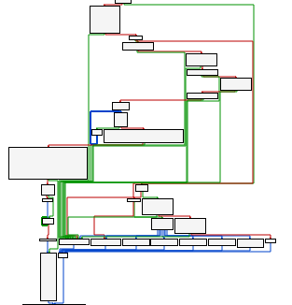
HTTP API
Guesswork
0x30, NULL, etc
Live debugging
Useful http functions
cellHttpSendRequest()
cellHttpRecvResponse()
cellHttpUtilFormUrlDecode()
Modify served files
Hunt for function parsing the results
Notes:
MGO1 - guess work worked great, 0x30

Slide 26
HTTP API
Example of Authentication Logic
Receive http request
Validate on your backend
Was it successful?
Send generic ‘Success’ response to console
Was it invalid?
Send generic ‘Invalid’ response to console

Slide 27
HTTP API (SSL)
SSL Certificate
buy domain?
purchase certificate for root CA?
hash collision?
patch/disable SSL?
PS3 SSL Store
In flash (CFW necessary to modify)
Also loaded by ELF
Can host with our own SSL certificate

Slide 28
Reversing the Protocol

Slide 29
Reversing the Protocol
Packets! Packets! Packets!
Cannot get packets if the server is dead
Examine and compare everything
Notes:
Packets make everything easier. Complete capture and this isn’t too difficult. The more that is missing the harder it becomes.

Slide 30
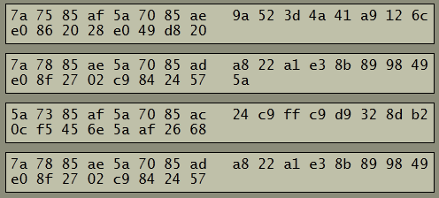
Client Packets
Notes:
Step one: read the data, anyone understand this; read hex?
I see an A (4th from right on top)
Zp also
Maybe viewing the ascii would help

Slide 31
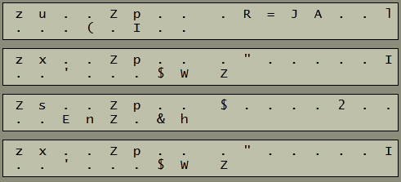
Client Packets
Notes:
There is the A
And Zp … Zp … Zp … Zp … in all of them, interesting.
Maybe a larger packet will help?

Slide 32
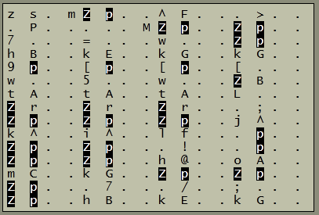
Notes:
Larger packet in ascii help? If you’ve not encountered this before this can stump you for awhile. But once you know it its easy to spot.

Slide 33
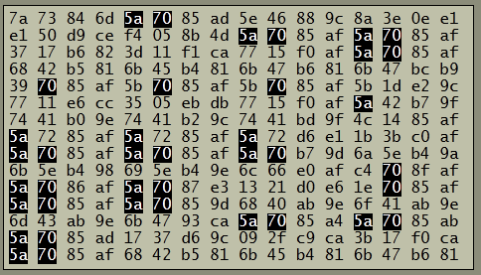
Notes:
Looking at the hex another thing stands out 85 aX after the Zp

Slide 34
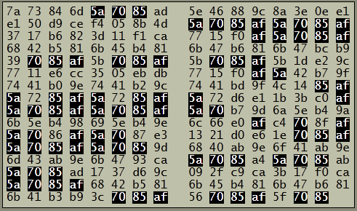
Notes:
Notice columns also 70s always in one column 85 next to it….so what is this encryption being used

Slide 35
Reversing the Protocol
No NULL bytes
..Zp comes up often

Slide 36
And it’s XOR…
Notes:
Key is used by MGO1 and MGO2
Now we can read the packets but now what? We need to understand it not just view it. We need to understand the protocol so lets look at more packets

Slide 37
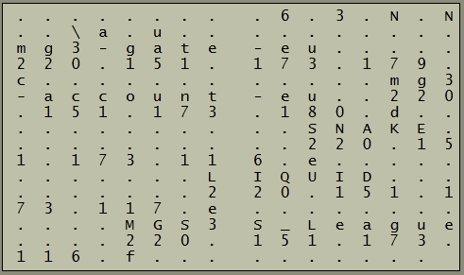
Notes:
Its the lobby listing mgs3-gate-eu 220.151.173.179
mgs3-account-eu 220.151.173.180
More about this packet later, but first lets figure out the protocol

Slide 38
Notes:
Header: First 8bytes + 16byte ??? = 24bytes
First Arrow(right most): Sequence
Second Arrow(middle): Payload Size
Third Arrows(left most): Command identifiers
Bottom Box: Payload
Top Box: ???

Slide 39
Reversing the Protocol
c022b8e51bd997c3baf6a587ba395d8f
f252244cd1f91de6baffa2ad93f4a1f8
7eb97a668342081d5685c0c100dfa3c7
f252244cd1f91de6baffa2ad93f4a1f8
Look familiar?
MD5 (Header + Payload)
Notes:
Note about PS3 and MD5 + HMAC

Slide 40
Reversing the Protocol
Header (8 bytes)
Command Identifier (2 bytes)
Payload Length (2 bytes)
Sequence (4 bytes)
Hash (16 bytes)
Payload?
Notes:
Header was shortest part of the process
Payload is the data segment of this protocol

Slide 41
Response Payloads

Slide 42
The Ideal Way
Packet Captures
Replay and experiment
Matter of determining transformation

Slide 43
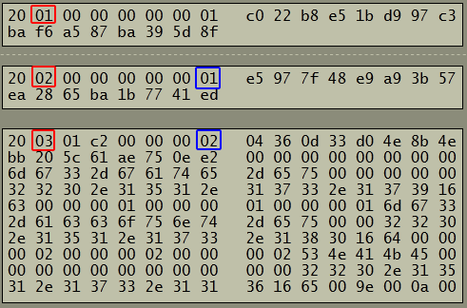
Notes:
------ split betwen client request and known server response
Commands are in red
Request on Top 0x2001
Response is 0x2002 and 0x2003
Blue is sequence they are independent of each other
Lets look at payload

Slide 44
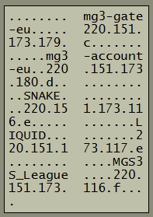
Notes:
Looking at text, can be sure this is the lobby listing; makes sense as first request
SNAKE LIQUID MGS3_LEAGUE = Lobby Names from original
Looks like IP Strings after it

Slide 45
Notes:
45byte groupings
Name and IP are always 15bytes+NULL each
2 byte port number (c d e e f)
What about first 8 bytes and last 4? {{CLICK}}
…{{CLICK}}First 4 bytes seem to just be an index
{{CLICK}} Next four are weird 00 01 02 02 02 02 compare with their lobbies == Type
{{CLICK}} 01 02 0a 0b 0c -- Took a little while, globally unique id (Japan had 00-09 or type 2)

Slide 46
Experimentation
Changed visible names
Changed IPs and setup listeners
Changed Unknown value to [A-E]
Hopefully its visible in some way

Slide 47
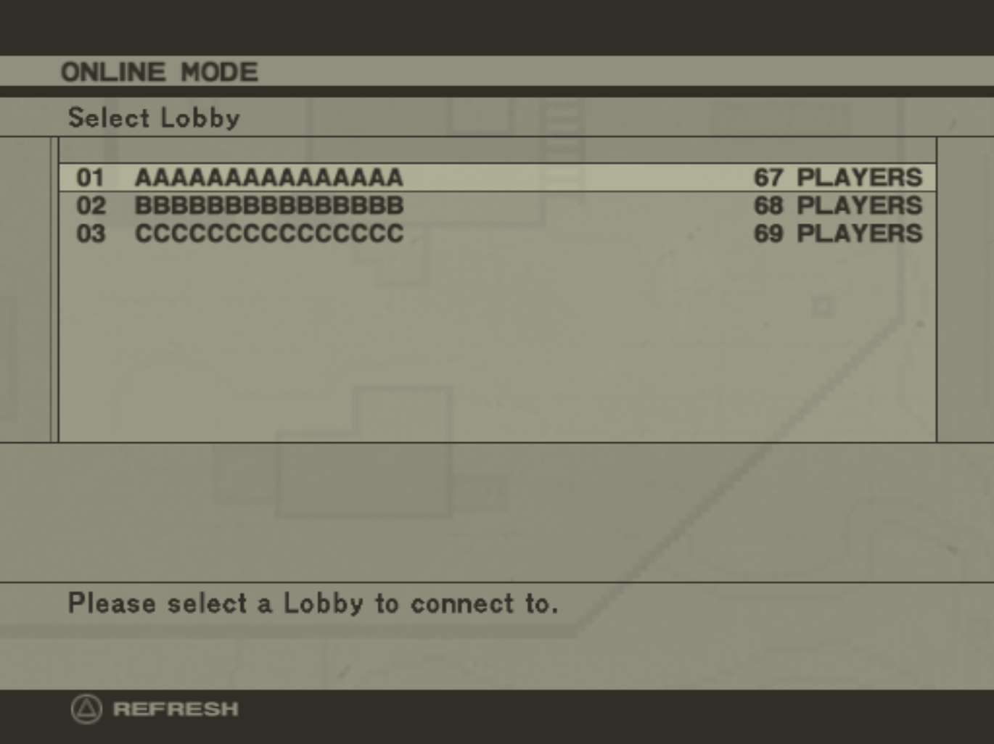
Notes:
We see the names as expected
Trying to connect takes me to the 192.168.1.3 IP as expected
And we see plaer count as 67, 68,69 which is C D E
Now its a matter of implementing the programming logic to return lobbies in this way.

Slide 48
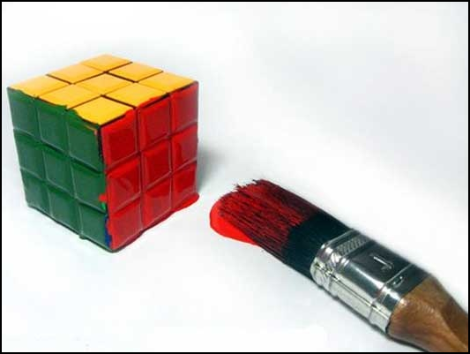
That was easy

Slide 49
The Harder Way
No packet capture

Slide 50
Determining the Payloads
Are there are commonalities that run through the payloads.
Is there are structure to the payloads?
XML? JSON? SOAP? Custom?
Cryptography
https://kerckhoffs.googlecode.com/files/Groebert-Automatic.Identification.of.Cryptographic.Primitives.in.Software.pdf
Notes:
Try to determine if there is a structure to the payload

Slide 51
Determining the Payloads
No known format
First 4 Bytes are normally an error code
Server Command id is usually +1 of the request
Notes:
No known format for Metal Gear Online; just binary data

Slide 52
Determining the Payloads
Experimentation
First 4 bytes are a result code
0x00000000 = Success (normally)
Anything else is displayed back to user
Error only display IFF Command id is correct
Notes:
Experimentation let us learn some important things. This was literally just trial and error.

Slide 53
Determining the Payloads
Command Identifier
Loop with error until an error is displayed
Notes:
First thing to determine the payload is to determine the command identifer
Since errors are only dispalyed if the command id is correct we can just send 50 command ids with errors and see which error we get

Slide 54
Determining the Payloads
Guess Work
Blank
User Settings
NULL (0x00)
Create Game - first half
‘0’ (0x30)
HTTP API
Success (0x00000000)
‘Worked’ in most places but garbage data
Something else?

Slide 55
Determining the Payloads
Fake Success (0x00000000)
Worked to trick the client into going on
Functionality didn’t work
but console accepted it

Slide 56
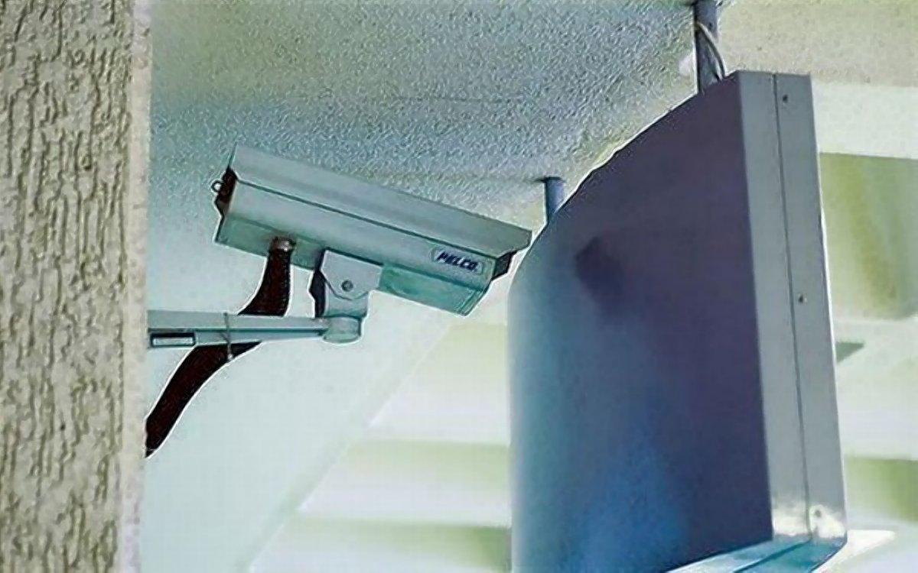
User Settings
No error from client so thats nice
Not useful unless we can read and save it

Slide 57
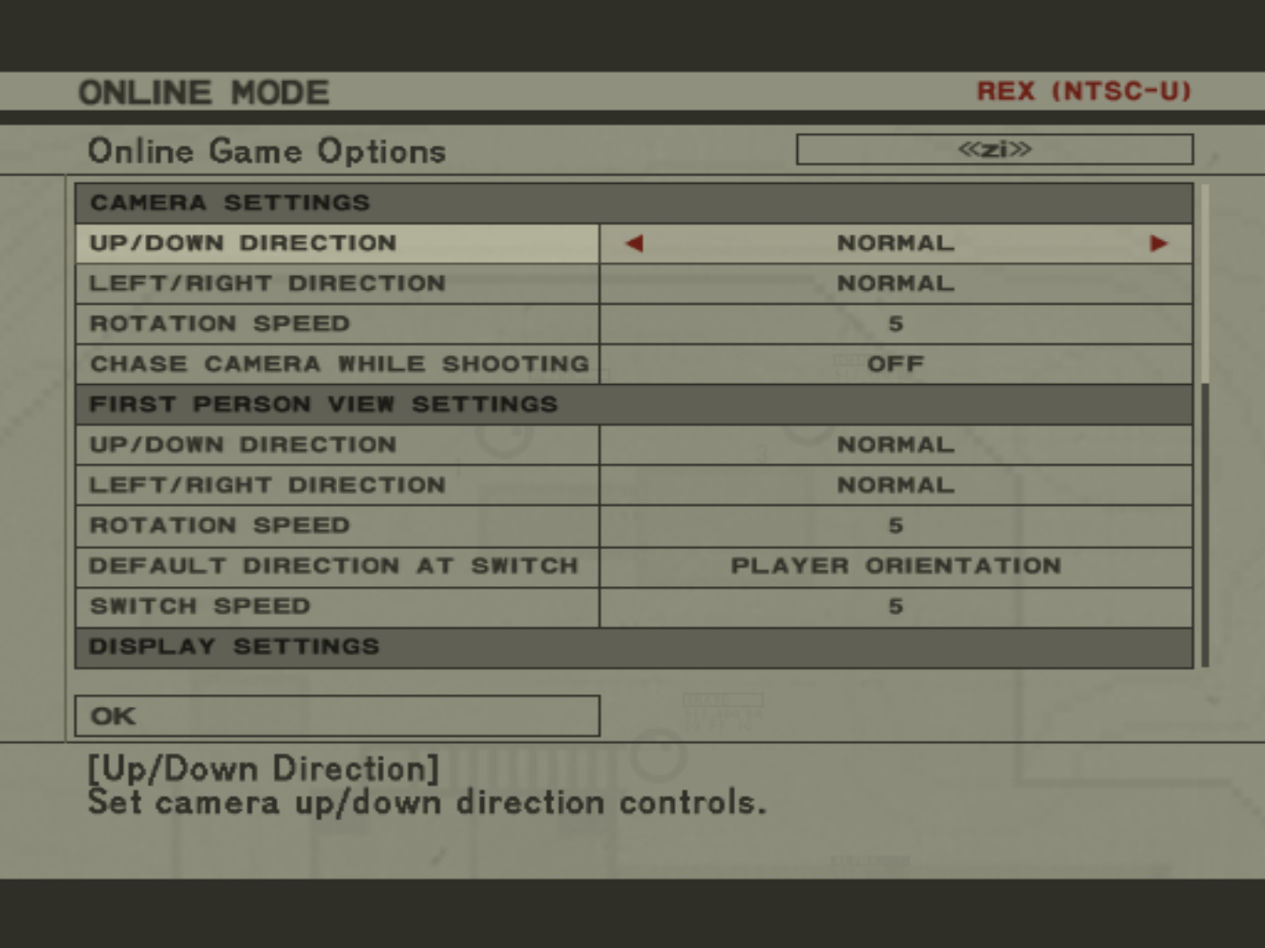

Slide 58
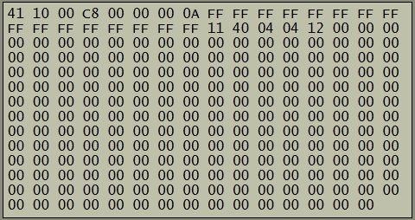
Notes:
Step 1: figure out command id for reply: 0x4111, tested by sending an error code
What is the rest of this though, make a single change and try again
Changed the 3 rotation Rotation Speeds to 10

Slide 59
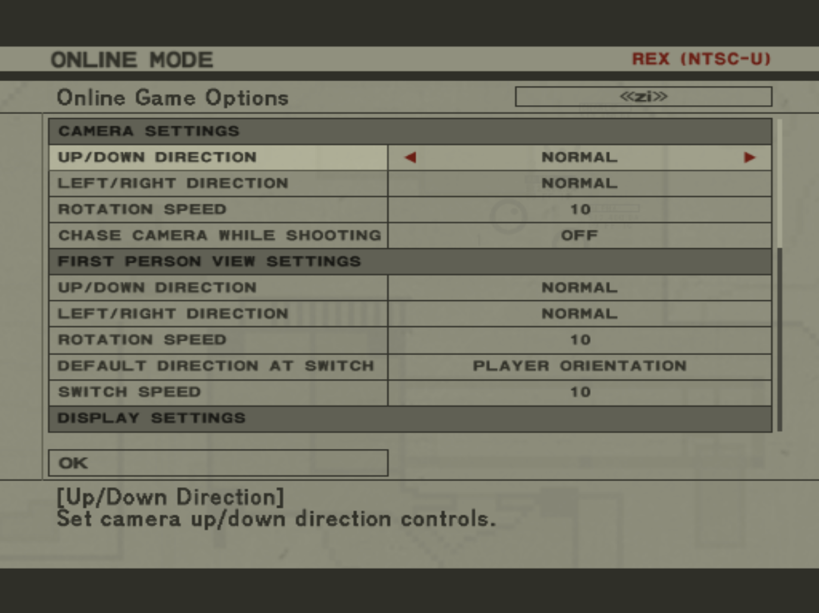

Slide 60
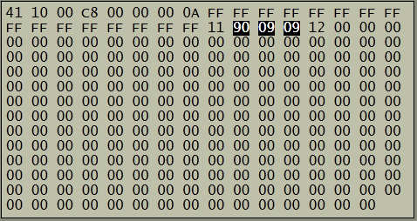
Notes:
Three 9s appeared
Went through every option one by one figuring out what change it made
Tedious but trial and error worked to figure out what every bit meant.
If you’re wondering all the 00s are 16 character strings you can set 12 to type quick messages. That was easy enough to figure out by just setting As to see them

Slide 61
Exploring Items
00 00 00 24 04 00 00 02 01 0B 04 00 40 40 0C 00
00 00 01 10 00 00 00 01 11 00 00 00 04 12 40 F8
A3 16 16 04 00 40 44 21 00 00 00 01 26 00 00 ..
Number of entries?
Makes sense
First byte is ascending
Item ID
Followed by 4 bytes
Colors
Lets play with it...

Slide 62
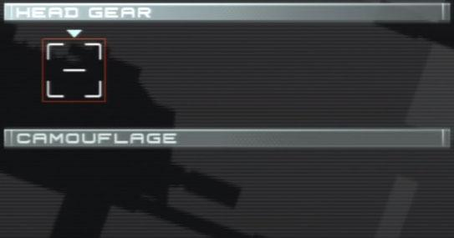
Exploring Items
00 00 00 00 21 00 00 00 01
Notes:
Last bits: 00 01, 00 11, 01 11

Slide 63
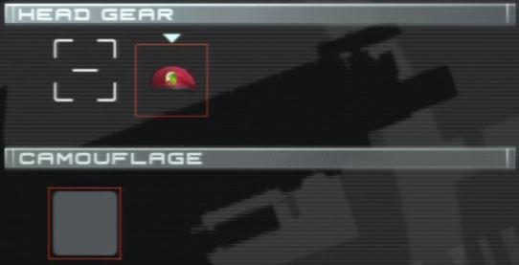
Exploring Items
00 00 00 01 21 00 00 00 01
Notes:
Last bits: 00 01, 00 11, 01 11

Slide 64
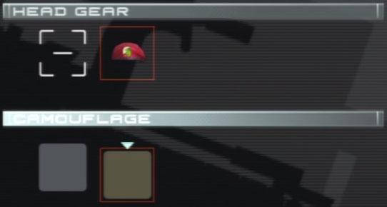
Exploring Items
00 00 00 01 21 00 00 00 03
Notes:
Last bits: 00 01, 00 11, 01 11

Slide 65
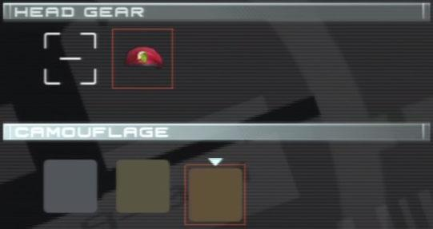
Exploring Items
00 00 00 01 21 00 00 00 07
Notes:
Last bits: 00 01, 00 11, 01 11

Slide 66
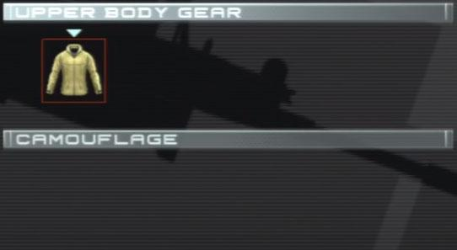
Exploring Items
00 00 00 00 21 00 00 00 01
Notes:
Note first picture: jacket is a placeholder item, if no gear is present
Cool items: KikuTaro Mask (nonpublic), World Championship Shirt (limited)

Slide 67
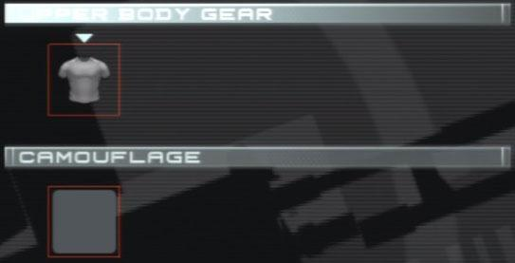
Exploring Items
00 00 00 01 21 00 00 00 07
Notes:
Note first picture: jacket is a placeholder item, if no gear is present
Cool items: KikuTaro Mask (nonpublic), World Championship Shirt (limited)

Slide 68
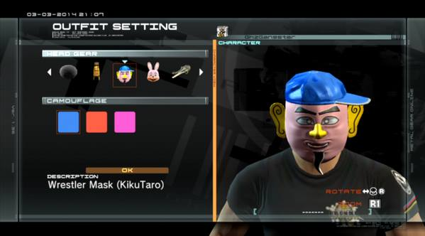
Exploring Items
Notes:
Note first picture: jacket is a placeholder item, if no gear is present
Cool items: KikuTaro Mask (nonpublic), World Championship Shirt (limited)

Slide 69
User Settings
Slow and tedious but not too difficult

Slide 70
Complex Payloads
Packets? Nope.
Easily Guessable? Nope.

Slide 71
Friends List
Exhausted simple cases
Random payloads revealed nothing

Slide 72
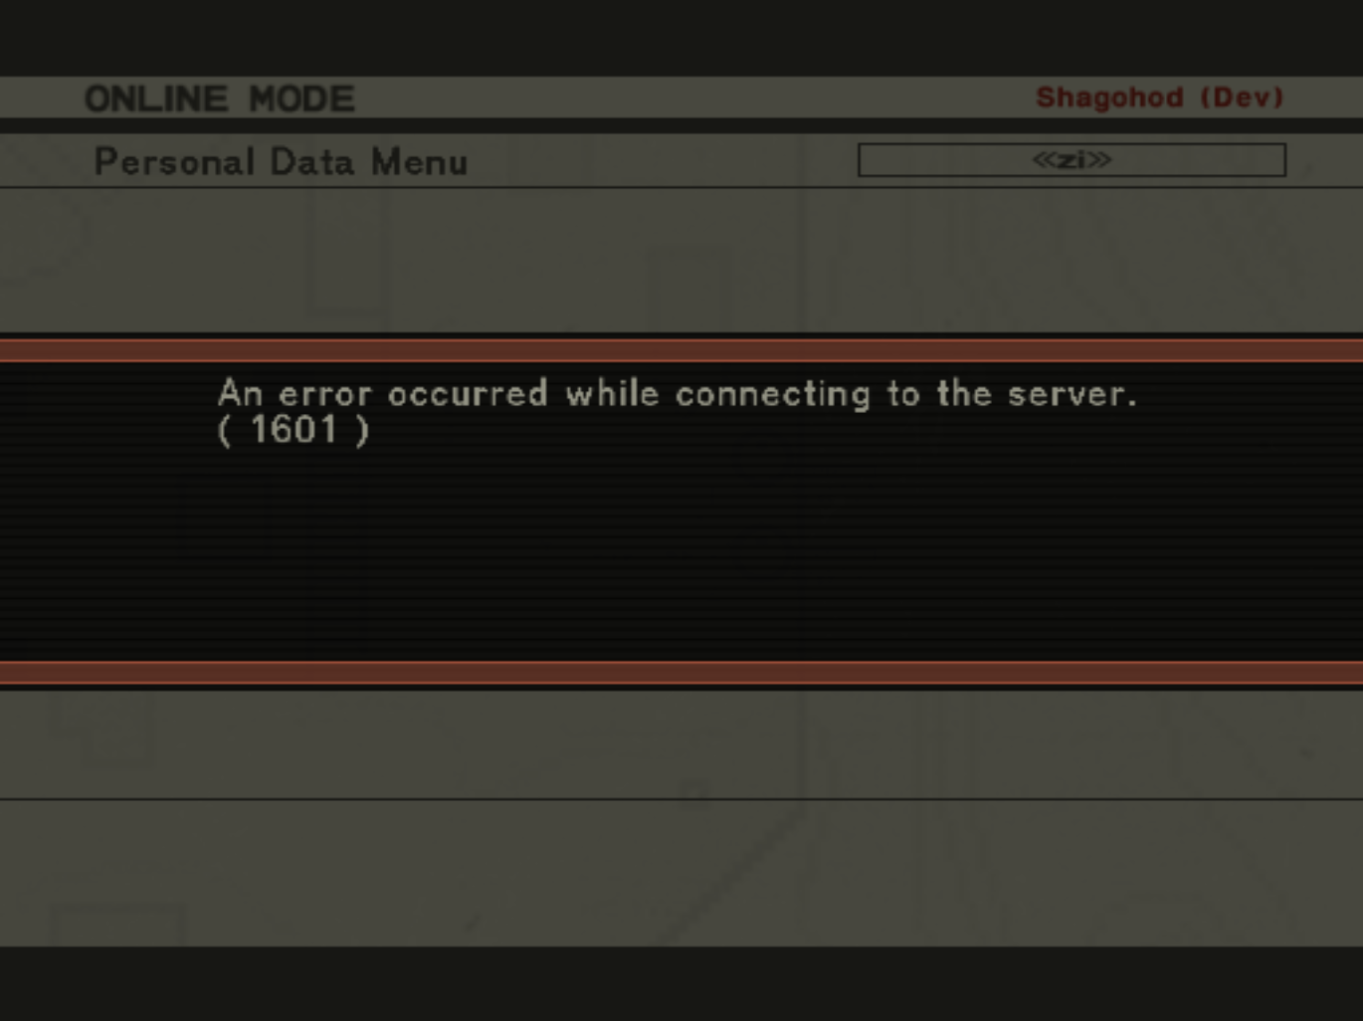

Slide 73
Friends List
3 types of packets seen else where
Client Updates
Client Requests
Lists
Notes:
As simple guess work didn’t work we had to look elsewhere, so we examined patterns we had seen elsewhere on the server and discovered 3 classifications of packets:
Client Updates - Like Updating your settings, client sents some data and expects you to tell it if it was updated successfully
Client Requests - Like the lobby listing, client sends a request for data and expects a blob back.
Lists - Things like listing of friends or games where there is a variable amount of data coming back
Client Updates are easy, just send a success code and figure out how to read the data.
Client Requests are harder. In the lobby listing we had a known packet to figure out from; what if you don’t have that?

Slide 74
Friends List
Game Listing used an alternate format
Empty start packet
Element packet containing all the binary data
Empty end packet
Attempt
Receive 0x4580
Send
0x4581 - {Empty}
0x4583 - {Empty}

Slide 75
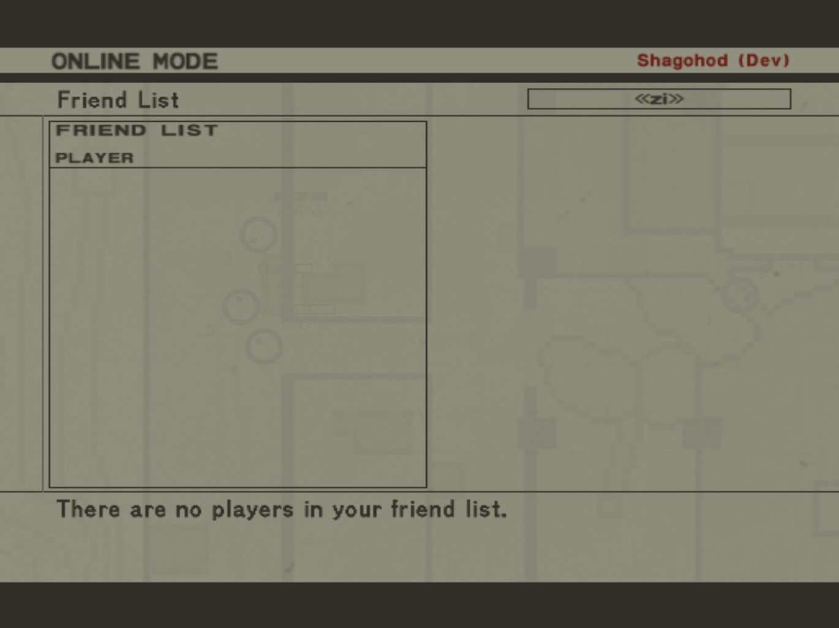

Slide 76
Friends List
Progress!
Now to determine content of 0x4582
perl -e 'print "A"x100'

Slide 77
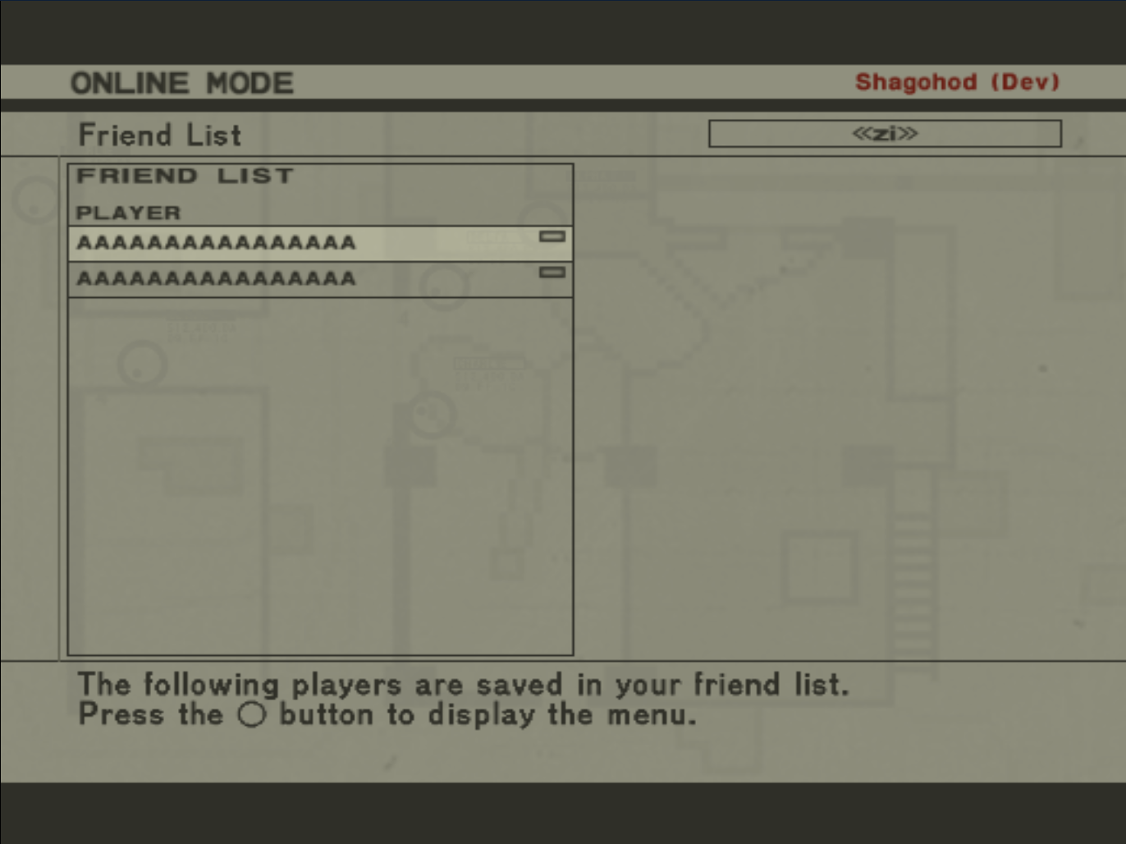
Notes:
So 100bytes is enough for 2 Friends list elements now to figure out how big each one is

Slide 78
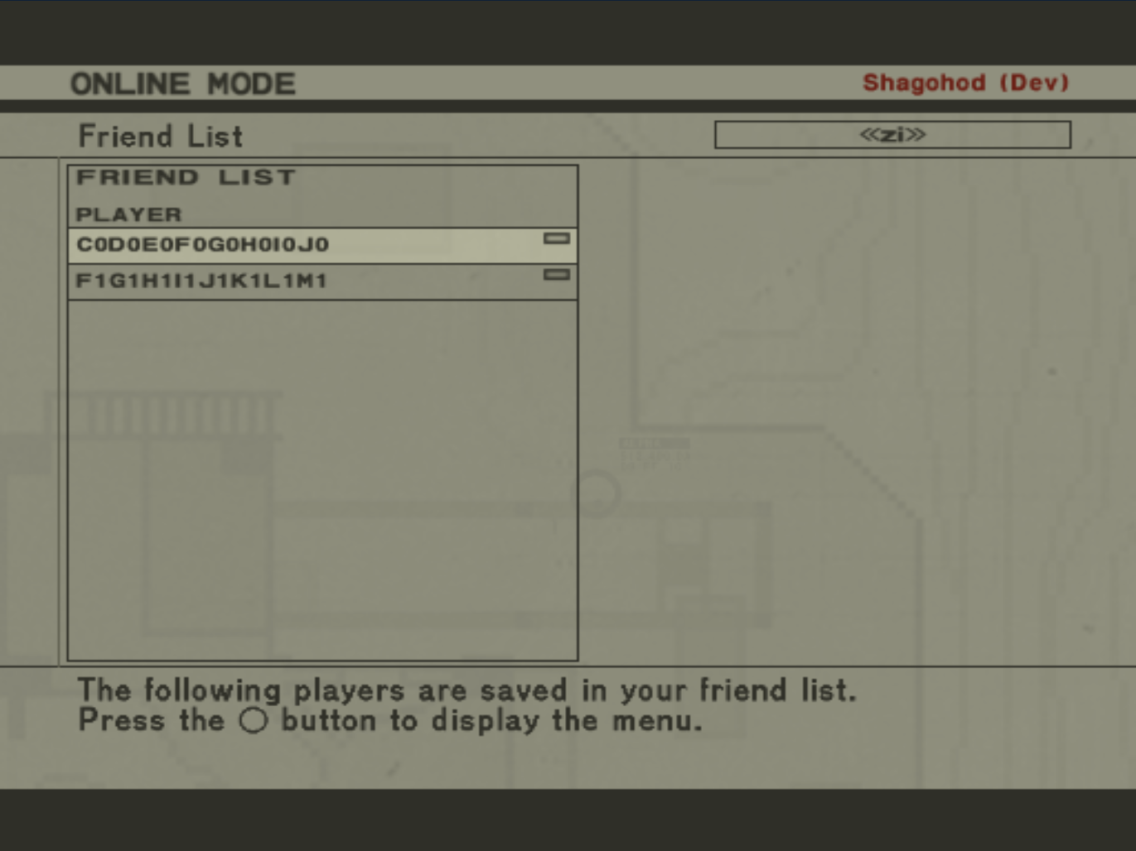
Notes:
A0B0 (4bytes) missing at start
K0 trough E0 missing in between(42bytes)
Presummably 4 of those bytes belong to Player 2,

Slide 79
Friends List
Notes:
There is the A0B0, first 4bytes is player id but what about the rest?

Slide 80
Friends List
Structure (58 Bytes)
Player Id - 4 Bytes
Player Name - 16 Bytes including \x00
Unused - 38 Bytes
Seems inefficient...

Slide 81
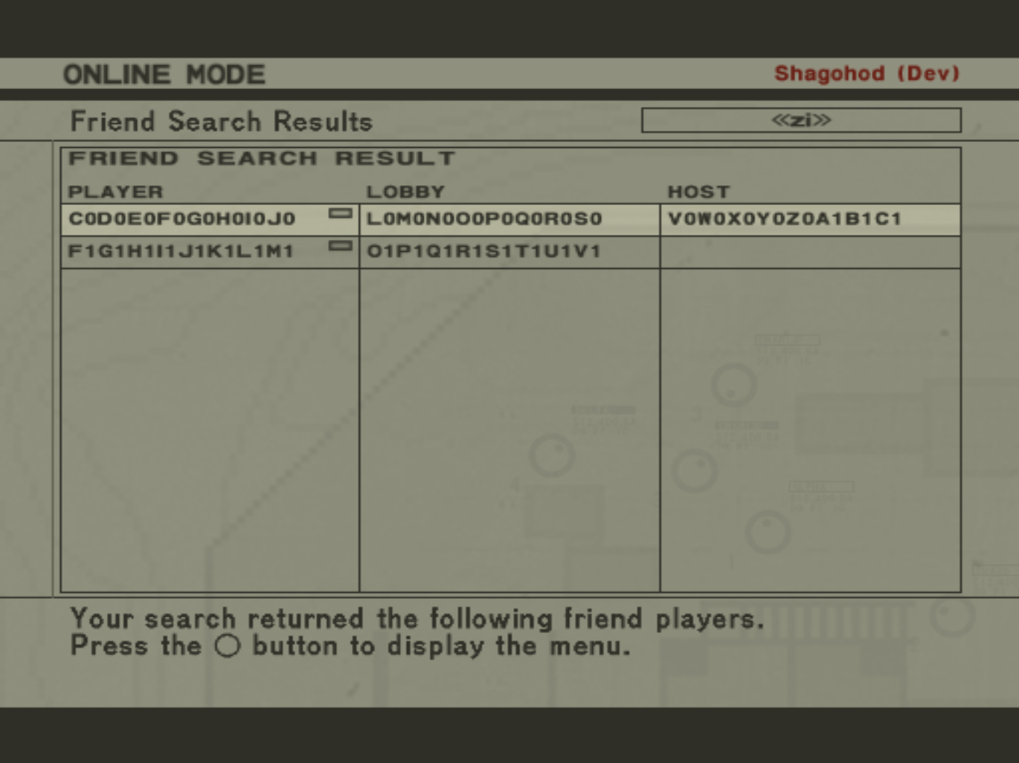
Notes:
Turns out the request is reused elsewhere, reveals more information
K0 is missign between Player and Lobby names
T0U0 missing between Lobby and Host Name

Slide 82
Friends List
Structure (58 Bytes)
Player Id - 4 Bytes
Player Name - 16 Bytes
??? - 2 Bytes
Lobby Name - 16 Bytes
??? - 4 Bytes
Game Name - 16 Bytes
Notes:
Experimentation with “Jump to host” lead to understanding the 6 unknown bytes

Slide 83
Friends List
Structure (58 Bytes)
Player Id - 4 Bytes
Player Name - 16 Bytes
Lobby Id - 2 Bytes
Lobby Name - 16 Bytes
Game Id - 4 Bytes
Game Name - 16 Bytes

Slide 84
Join Game
Packets? No. Easily Guessable? Nope.
Anything similar? Nope.
Notes:
Multiple Steps, unknowns requests and unknown responses

Slide 85
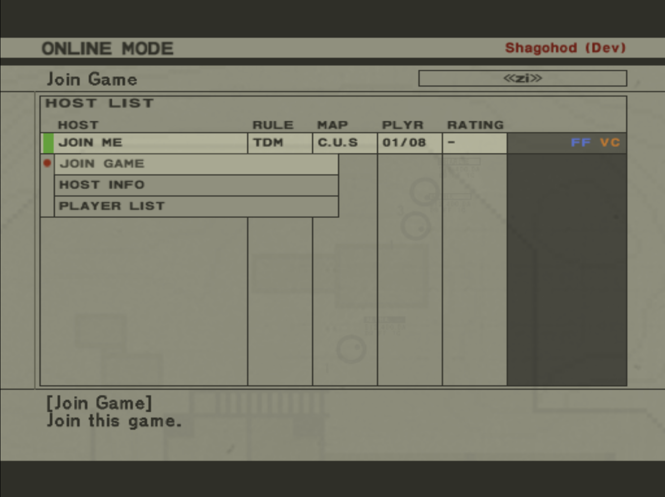

Slide 86
Join Game
Step 1
0x4113 - Game Data
Same request is made for ‘Host Information’
Used Host Information to determine response

Slide 87
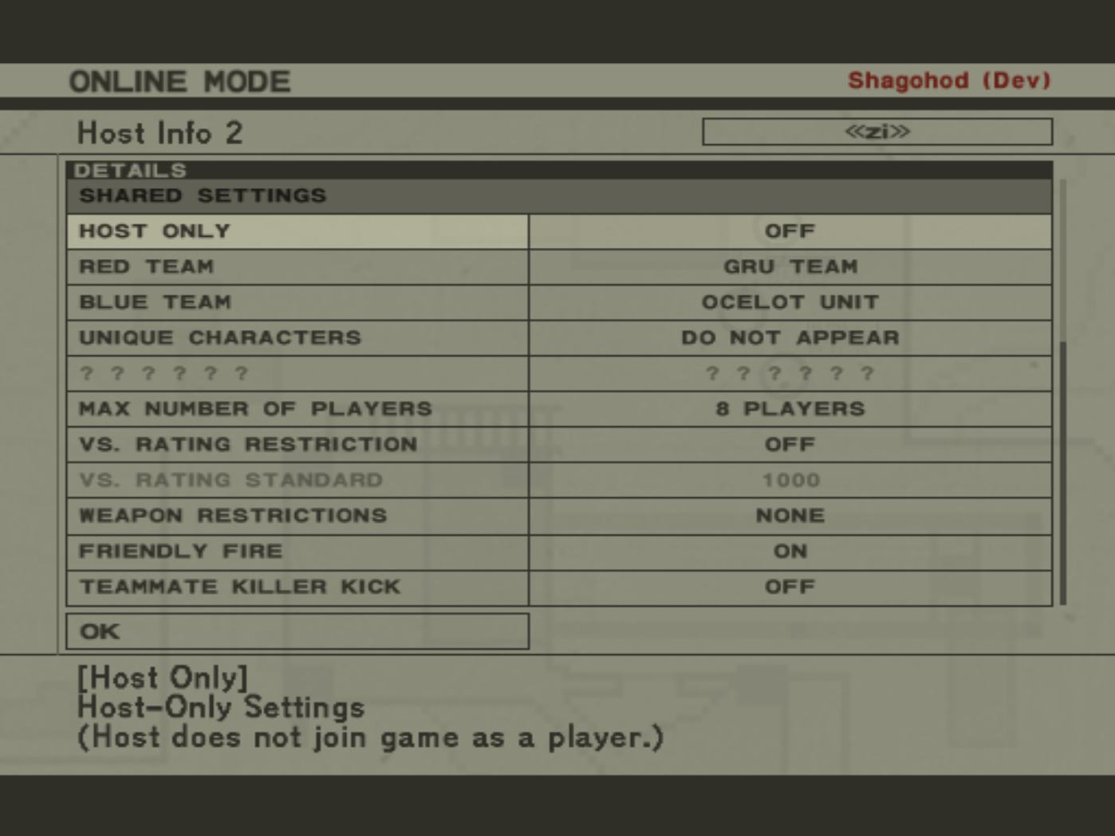

Slide 88
Join Game
Step 2
0x4102 - Player Stats
Requests information about the host’s ingame stats
Notes:
We know what this is supposed to be because of an existing menu item don’t know how to response

Slide 89
Join Game
Static Analysis
ELF is packed
No official debugging functionality
Emulator memory dump

Slide 90
Join Game
Finding the code path
Nearby strings
None
Magic Numbers
0x4103
XOR Code
Notes:
Follow references of XOR up to command ids

Slide 91
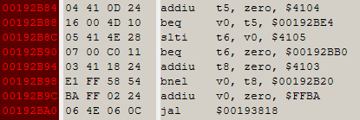
Join Game
Notes:
Found magic numbers, 0x4103 is the one that gives an error so follow it.

Slide 92
Join Game
Function has several calls of the form
jal -- function call
bne v0 0 -- branch if return not 0
Repeat about 15 times
Notes:
Found magic numbers, 0x4103 is the one that gives an error so follow it.

Slide 93
Join Game
Two Options
Follow code path and determine where it fails
NOP the check (Patch)
Determine what data would make it pass
Complicated payloads
Expects data for 0x4104 and 0x4105
Ultimately patched

Slide 94
Join Game
Past Requests
Game Information
Player Information
Host Stats -- patched
now 0x4320?
Notes:
Now I really don’t want to reverse all this data, reversing is really a last ditch option

Slide 95
Join Game
External Resources
Google is your friend
Other online games
Pro Evolution Soccer
Metal Gear Online 2
Had this particular packet
Notes:
Now I really don’t want to reverse all this data, reversing is really a last ditch option
PES6 was not super helpful but it was a resource and it confirmed some of our thoughts so I do want to give credit to Mohamed Saher he did similar work on the PC version of PES6 and was willing to answer some of my questions about PES6.
MGO2 - joining game has a rather different flow but this packet is part of it.
Response 0x4121 contains IP(External, Internal) and Port for host connection

Slide 96
Join Game
Client sends data over UDP to Host
Unexpectedly host sends 0x4340
Notes:
We see UDP communication to host from client, looks good

Slide 97
0x4340
No error message
Host stops responding to client UDP
Request Payload
Joining Player Id

Slide 98
0x4340

Slide 99
0x4340

Slide 100
0x4340
Found 4341 handler in memory dump
Function makes a lot of calls but doesn’t check return values
Only reads 4 bytes from payload
Notes:
When looking through the assemble I notice it makes a call to grab one chunk from payload, most other commands loop this call but this one just calls it once.

Slide 101
0x4340
Notes:
Critical call to 00190020 arguments:
$a0 = pointer to payload
$a1 = word from stack
$a2 = word from stack
Expects return 0;
Critical value so patching didn’t work we need to make the function return 0
After some exploration a1 == Joining players id
Function checked if the 4bytes read earlier == a1, proper response is the joining players id

Slide 102
0x4341
Structure
Success Code - 4 bytes
Player Id - 4 bytes

Slide 103
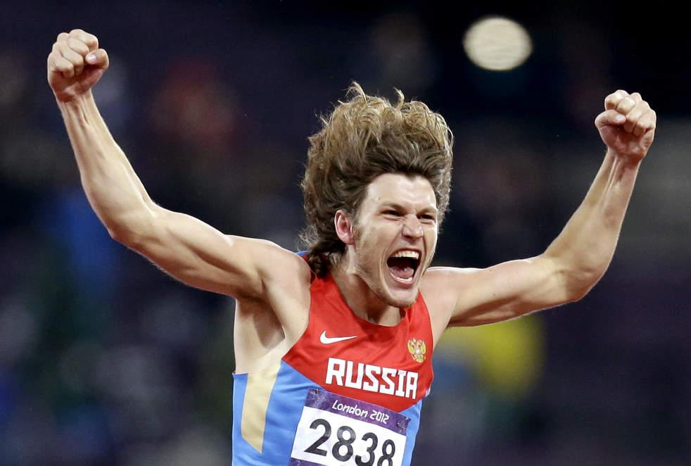
Success!
Notes:
Finally joined a game for the first time in 6 years

Slide 104
Conclusion

Slide 105
Warnings
A lot of work
Protocol and Server emulation took about 10 months of casual work
Headaches and frustration
Not a lot of existing reference material
People are crazy
Trolls and complaints about not being done yet
Copyrights and DMCA
DMCA exception for interoperability
Terms of Service
Notes:
A lot of work, a lot is not shown here even after joining the game we then had to handle packets sent while ingame like joining a team, stats, new round information

Slide 106
Credits
GhzGangster (Derrik Touve)
Zak
http://obsvr.com
Mohamed Saher
http://twitter.com/halsten
http://halsten.info
Wtfareuthinking1
Jayveer
Notes:
Ghz / Derrik “too-vee”, co-developer
Zak - Initial ground breaking and DNAS bypass on emulator, worked on Resident Evil Outbreak server
Mohamed Saher - PES6 server, was willing to answer some of my questions about PES which confirmed some of our thoughts for MGO
Wtf - MGO2 dev
Jayveer - Reversing file formats on MGO2

Slide 107
Useful tools
Used public IDA scripts to parse PS3 ELF
https://github.com/kakaroto/ps3ida
Revealed SDK functions and references
More analysis in general than PS2

Slide 108
Questions?
Matthew Halchyshak
matthew@0x0539.net
Joseph Tartaro
joseph.tartaro@ioactive.com
@droogie1xp

